Slide 1
Players Guild of Dearborn
Redeeming Member Tickets Online
September 2021

Slide 2
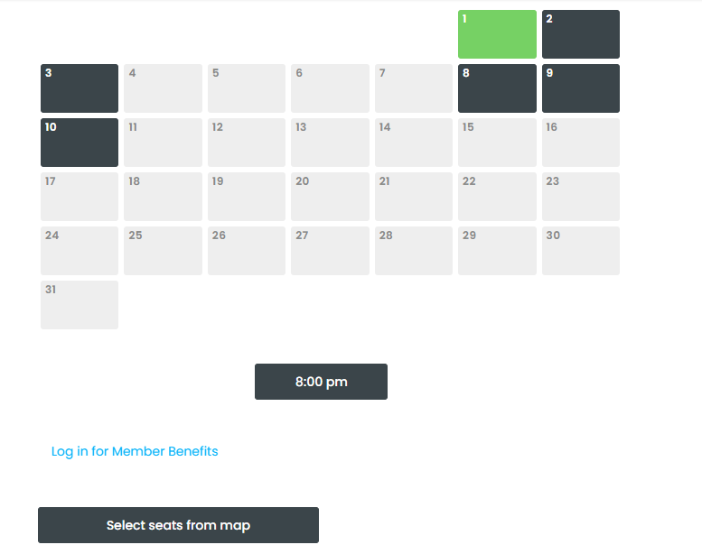
Buying Tickets
Select your date from the calendar displayed. Once you do that, the date selected will turn green and the performance time will be displayed.
Under that you will see Log-in Member Benefits. Click on that link.

Slide 3
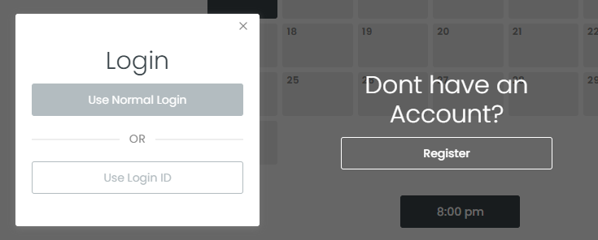
Buying Tickets
For your FIRST log-in, please select Register to activate your account.
All subsequent log-ins you will select Use Normal Login which will require your email address and password.
We do not use Login ID at the present moment.
You must use the same email address as your membership application, otherwise your complimentary tickets will not be activated.

Slide 4
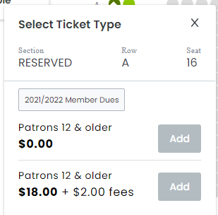
Selecting Seats
You will be able to redeem your complimentary admission as well as purchase additional tickets in the same transaction.
If you wish to redeem ONLY your complimentary admission select the price point that has the 2021/2022 Member Dues category and click Add.
Continue through the checkout process to complete.

